Slide 1
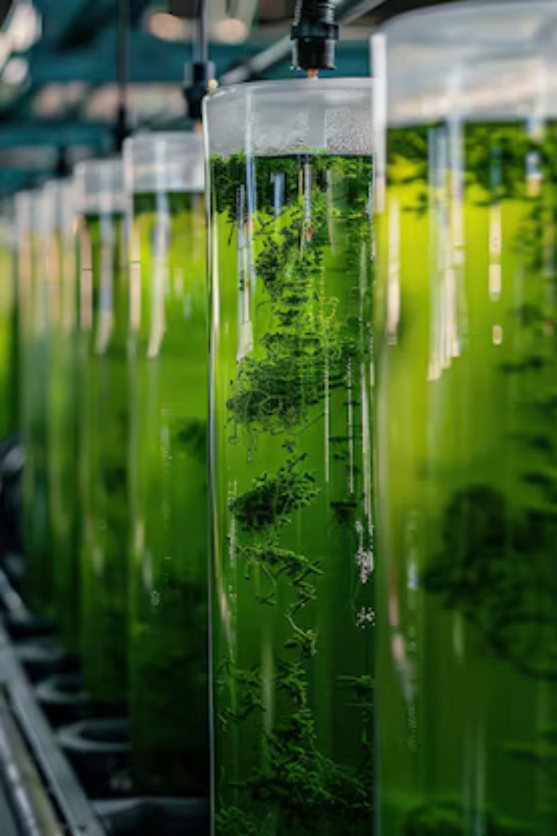


ALGAE-OPT AI
AI-Powered Algae Biofuel Optimization
Making Green Energy Smarter & Profitable
Kartik Kumar - 202401100500082
Mohd Ali Khan - 202401100500107
Rohit Arya - 202401100500145
Manish Kumar - 202401100500100
Course - B.Tech
Branch - CSIT Section - III(B)

Slide 2

Why Algae Biofuel Fails in Reality
Algae biofuel promises a sustainable energy future, but traditional cultivation faces significant hurdles that cripple profitability and scalability in the real world.
High Production Costs
Fuel costs are inflated, ranging from ₹65-85 per liter, making it non-competitive with fossil fuels.
Unpredictable Yields
Environmental variability (temperature, light, pH) leads to unpredictable output, reducing farmer confidence.
Low Success Rate
Traditional, non-optimized methods result in a low success rate—often just 40-50%—due to guesswork.

Slide 3
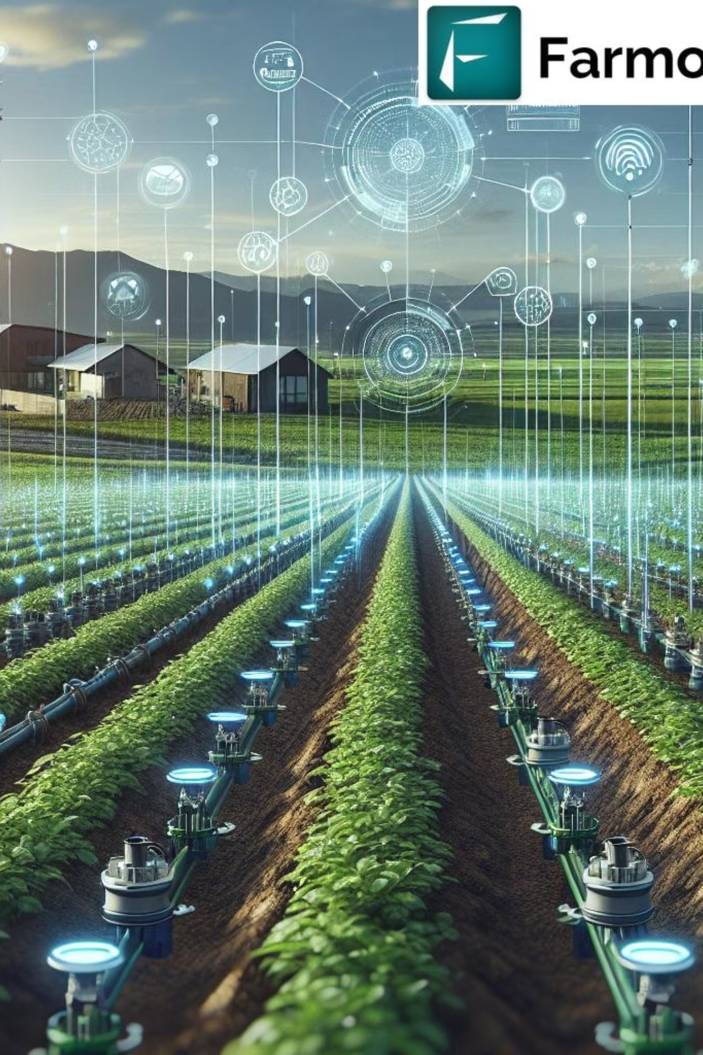



ALGAE-OPT AI: The Digital Farming Expert
Think of it as "Google Maps for Algae Farming"—providing the optimal route to maximum yield and profitability.
Recommends Optimal Strategies
Prevents Costly Mistakes
Predictive analytics identify risks before they occur, saving time and resources.
Pinpoint the best strain and cultivation parameters for any local environment.
Maximizes Profit
AI-driven profit projections guarantee maximum return on investment (ROI).

Slide 4




Simple 3-Step Process for Optimization
Step 1: Input Local Data
Enter your pond's local environmental conditions (sunlight, temperature, water quality) and your financial goals.
Step 2: AI Optimization
Our proprietary AI engine processes thousands of data points to recommend the single best algae strain and ideal growth parameters.
Step 3: Project and Produce
Simulate the outcome and instantly receive profit projections (in ₹) and a detailed action plan.

Slide 5



Powered by Smart Algorithms
Our predictions are built on a robust foundation of machine learning, integrating real-world data from leading research institutions like NREL and premier Indian research facilities.
Random Forest
Linear Regression & Time Series
Employed for complex, non-linear predictive modeling, achieving 95% accuracy in oil yield predictions based on environmental inputs.
Used for cost optimization, forecasting required nutrient/labor costs, and projecting long-term profitability and risk.

Slide 6




All-in-One Smart Dashboard
The ALGAE-OPT AI interface provides immediate access to all critical tools needed for successful, profitable cultivation.
Strain Selector
Growth Simulator
Profit Calculator
Live Monitor
Identifies the most robust and oil-rich algae strain for your specific climate and water source.
Test different scenarios virtually—adjusting light, pH, and nutrients—with zero risk or material waste.
Provides real-time, dynamic cost analysis and estimated revenue figures in Indian Rupees (₹).
Track actual growth against AI-predicted optimal growth curves, allowing for real-time course correction.

Slide 7

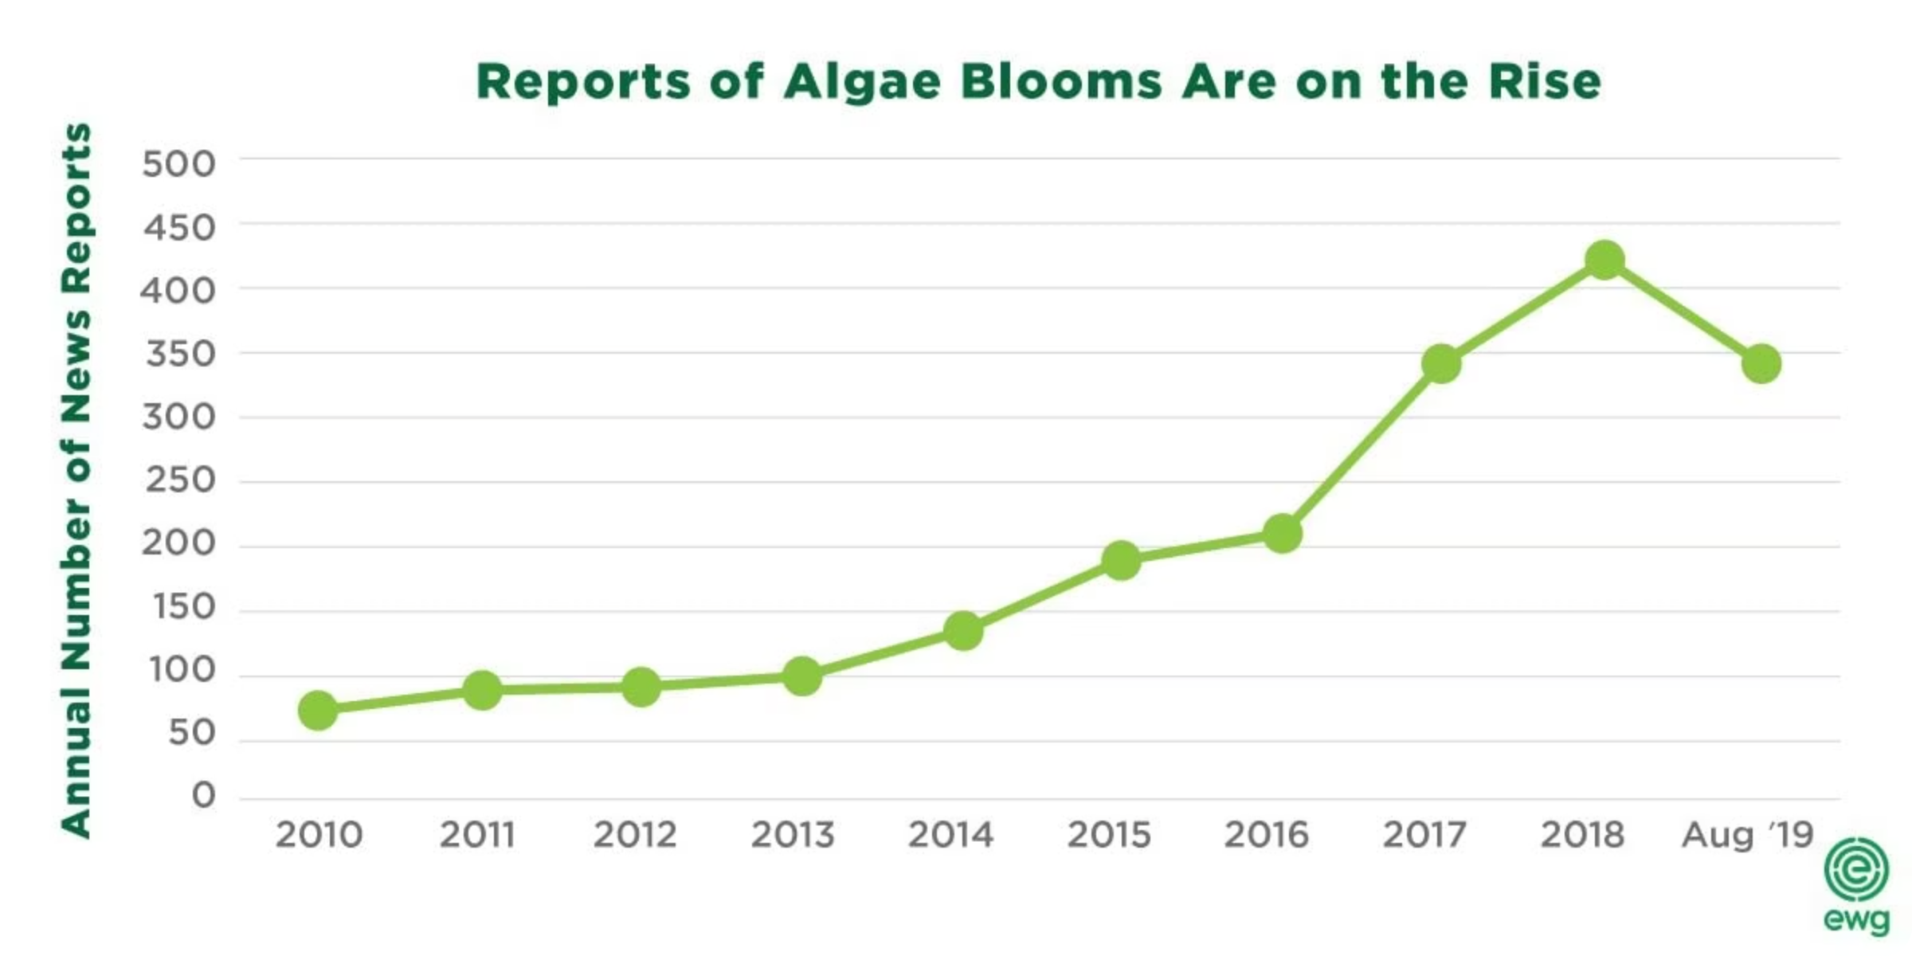
Proven Impact with Data
By removing guesswork and providing data-driven recommendations, ALGAE-OPT AI radically transforms the economics of algae biofuel production.
25-40%
30%
85-90%
Increase in Oil Yield
Reduction in Production Costs
Success Rate Achieved
Optimization of light and nutrient delivery leads to significantly higher lipid accumulation.
Minimized nutrient wastage and reduced labor hours due to precise management.
Moving from a 50% gamble to a reliable, high-probability operation.
8-12
ROI in Months
Accelerated profitability timeline ensures rapid scaling for farmers.

Slide 8

Perfect for the Indian Context
The unique features of India's economy and geography make it the ideal proving ground for AI-optimized algae farming.
1
Ideal Climate Conditions
India’s tropical climate provides year-round sunlight and warm temperatures—perfect for high-density algae growth.
2
Energy Security
Biofuel production significantly reduces dependency on volatile fossil fuel imports, boosting national energy security.
3
Utilizes Marginal Land
Algae ponds use non-arable, barren land and even wastewater, avoiding competition with food crops.
4
Creates Rural Employment
New, high-tech agricultural sector fosters sustainable employment opportunities in rural areas.

Slide 9
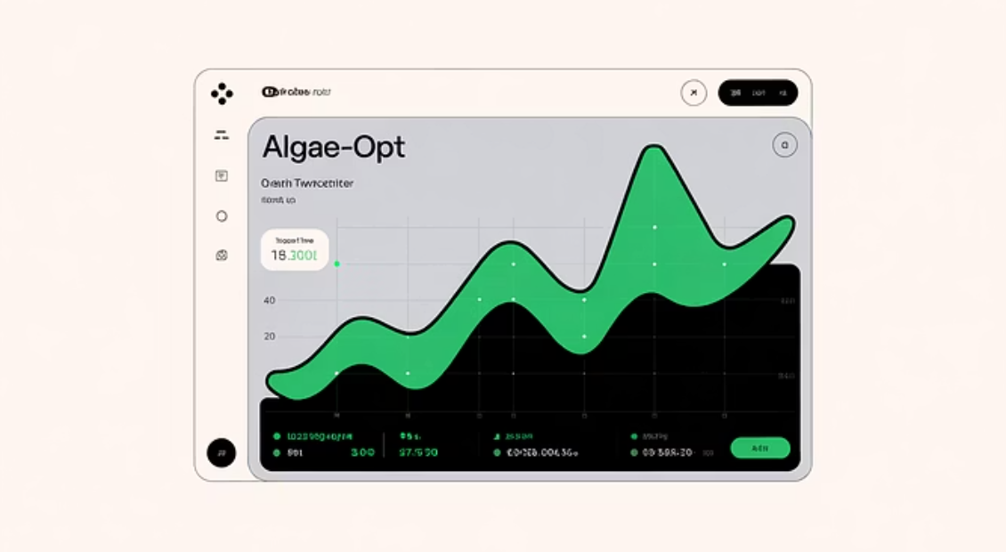
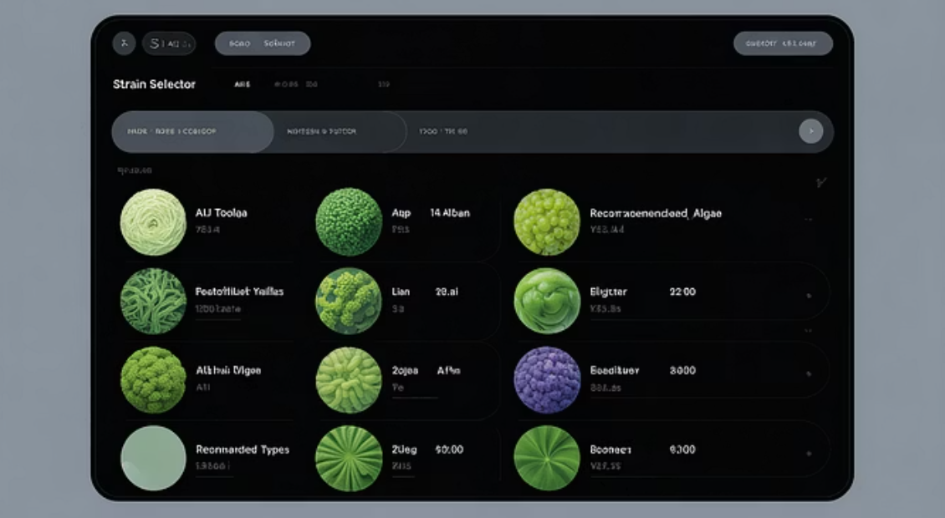

See It In Action: Prototype Showcase
We have developed a working, dynamic prototype to validate the AI models and demonstrate the user-friendly interface.
The ability to instantly visualize cost implications in ₹ (Indian Rupees) is a core feature that makes this tool immediately actionable and relevant to local farmers.

Slide 10


Transforming the Green Energy Future
“Making algae biofuel accessible and profitable for every Indian farmer.”
Let's build sustainable energy together!

